Slide 1




COVAX
Detecting Covid-19 with ECG and deep learning
Supervised by :
Dr. Ahmed Farouk
Dr. Eman Hossny
TA Eng. Hassan Murad

Slide 2


ABOUT US
Rofida Gamal Muhammed
Mohammed Mosaad Abdeltwab
Rewan Hisham Sultan
Dalia Hosny Ahmed

Slide 3


CONTENT
Introduction.
Motivation.
Problem Definition.
Proposed Solution.
Related work.
Project pipeline.
Dataset.
Dataset preprocessing.
Machine/Deep learning models.
Project Specifications.
Challenges and Future work.

Slide 4
Introduction
COVID-19 has rapidly spread with increased fatalities across the world leading to a long-lasting global pandemic.
COVID-19 can be fatal for people with medical problems
such as, diabetics, cancer, and heart failure.
AI in biomedical applications has helped in developing trained networks for reliable computer-aided diagnostic decisions.
Several deep learning models have been proposed in recent studies to identify abnormalities from medical images.

Slide 5
Motivation
Nowadays, detecting if patient has Corona virus or not using Polymerase Chain Reaction (PCR) test is so expensive and can’t be found in many places.
Some of patients who have Corona virus their heart has been affected.
Currently, most detection of covid-19 with AI based on
X-Ray.

Slide 6


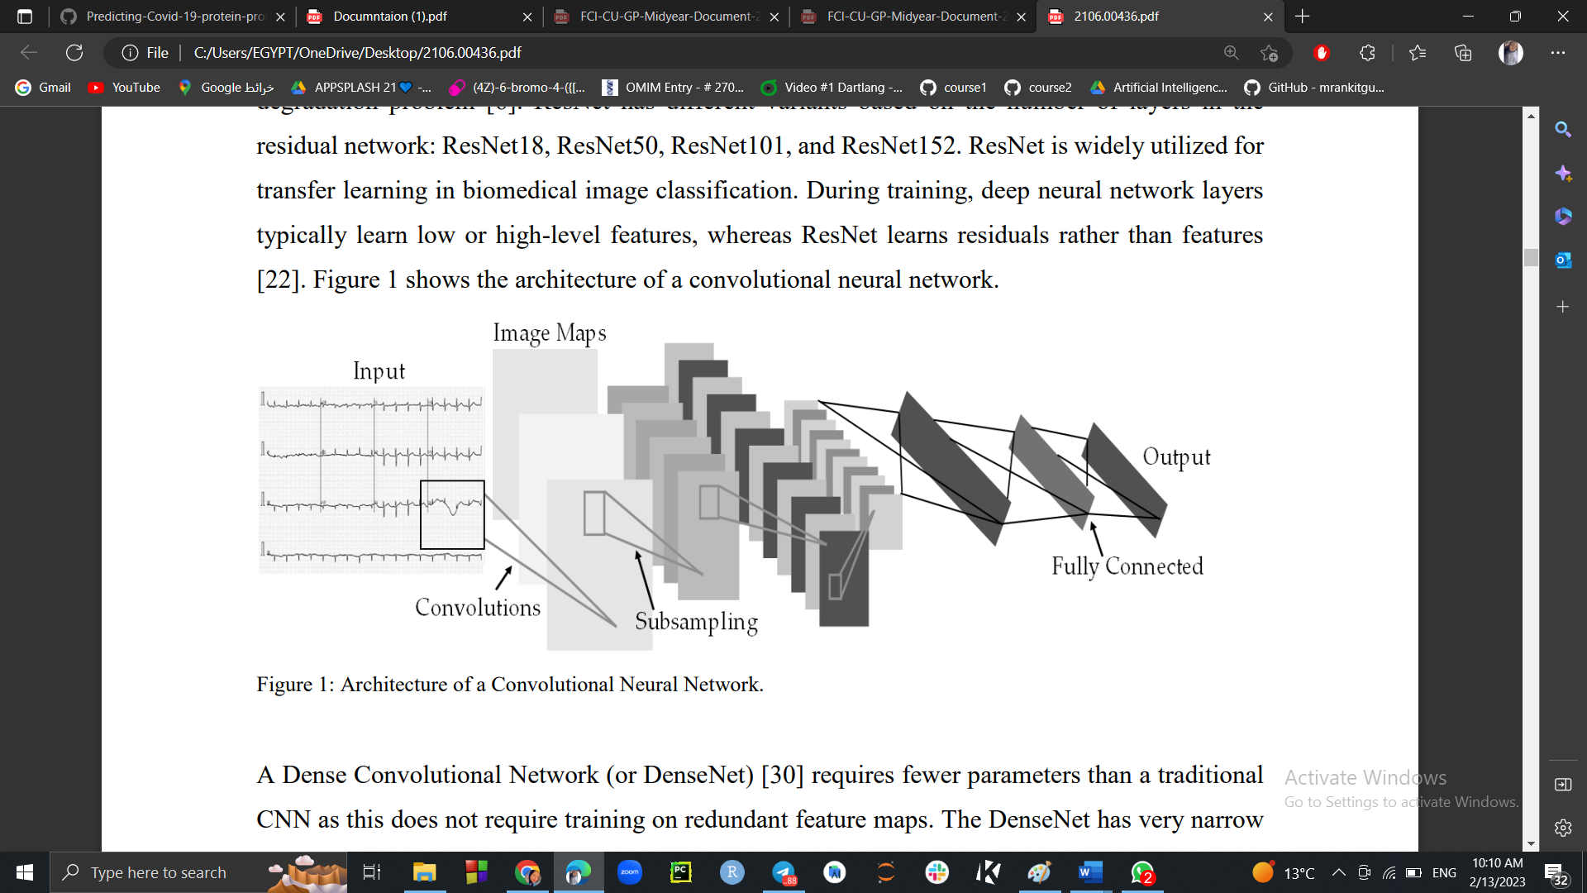
Problem Definition & Proposed Solution
Detection of Covid-19 using PCR is
Time Consuming.
Expensive.
Available only in specific places.
COVID-19 leads to heart failure.
Proposed:
Detection of Covid-19 & Heart problems
using ElectroCardioGram (ECG) is
Affordable.
Available.
Notes:
We are trying to detect Covid-19 with different way of X-ray.
Trying to find an alternative to the PCR that enables us to detect these diseases in an easy and accessible way for everyone.

Slide 7
Related Work
Paper name | Dataset source | Advantage | Limitations
COVID-19 detection using ECG trace images ……… . Published IN 2022. | Public dataset that contains ECG images of cardiac and COVID-19 patients. | Using CNN pre-trained models: ResNet18, ResNet50 ResNet101 InceptionV3 DenseNet201 Gamma correction for the preprocessing. Reach accuracy 97% using InceptionV3. | Not using machine learning Techniques before using CNN models. Used only Gamma correction for the preprocessing. CNN Which gives high accuracy take a large time to processed. The proposed models are trained and tested on a limited dataset.
Automated Detection of COVID-19 Using Deep Learning……….. Published IN 2023. | FR is the “ECG images dataset of cardiac and COVID-19 patients”. SD is the “ECG Images dataset of Cardiac patients” (heartbeats only). | CNN pre-trained deep learning models: Vgg16 Vgg19 Resnet 101 Xception SVM. preprocessing done in four stages: cropping the ECG images Using Temporary Convolutional Network (TCN), then finally we get a filtered COVID-19 ECG image report . Reach accuracy 97.5%, using ECGConvnet. | The proposed models are trained and tested on a limited dataset. Models that applied for training isn`t the best models. Accuracy isn`t the best in all models except SVM and VGG19. Diagnosis system that they used taking a long time to run.

Slide 8
Related Work
Paper name ` | Dataset source | Advantage | Limitations
COVID-19 detection using optimized weighted average……… . Published IN 2023. | This is a public dataset that contains RGB Images of scanned ECG reports of patients. | using CNN pre-trained deep learning models : VGG-19. DenseNet-121. EfficientNet-B4. OWAE. Using a new methods in preprocessing like, The optimized weighted average ensemble. Reach accuracy 99.09% using EfficientNet-B4. | Not using machine learning Techniques before using CNN models. The proposed model needs to be validated on large ECG datasets, because it `s trained and tested on a limited dataset. Accuracy isn`t the best in all models except CNN.
COVAX (Our Study). | Benchmarked data from (Kaggle & science-direct) FR is the “ECG images dataset of cardiac and COVID-19 patients”. SD is the “ECG Images dataset of Cardiac patients” (heartbeats only). | Using Shallow Learning (Lazy Classifier). Using different models of CNN : EfficientNet-B0 EfficientNe-B3 DenseNet201 InciptionNetV3 ResNet50 VGG19. Using more techniques for data preprocessing: Histogram of Oriented Gradients HOG Rectangle detection Gamma correction. Reach accuracy 98.065% using EfficientNet-B3. | The proposed models are trained and tested on a limited dataset.

Slide 9

Project Pipeline
Phase 1:
Collecting Dataset
Final Techniques are :
Histogram of Oriented Gradients
Rectangle detection
Gamma Correction
Trying different Preprocessing Techniques
Final Models are :
Lazy classifier.
EfficientNetB0.
EfficientNetB3.
DenseNet201.
InciptionNetV3.
ResNet50.
Trying and testing different machine learning and deep learning models

Slide 10
Project Pipeline
Phase 2 Deployment :
First user must make an account and login to the website or the mobile application:
Upload
Image
Processing the image
Upload to the Model
Predict and display the result
One of these:
Covid-19
Myocardial Infarction.
Abnormal Heart Beats.
Recovered Myocardial infarction.
Normal
EfficientNet B3

Slide 11
Dataset
The Dataset consists of ECG images and has been combined from kaggle & science-direct
It is a graphic tracing of electrical patterns produced by the heart.
The Dataset consists of 5 classes
COVID-19 Patients,
Myocardial Infarction (heart attack) Patients,
Patient that have abnormal heart beats, Patient that have History of MI, Normal Person).
The dataset consists of 1794 images:
Covid-19 | 250 images
Myocardial Infarction | 382 images
abnormal heart beats | 390 images
History of MI | 382 images
Normal | 390 images

Slide 12
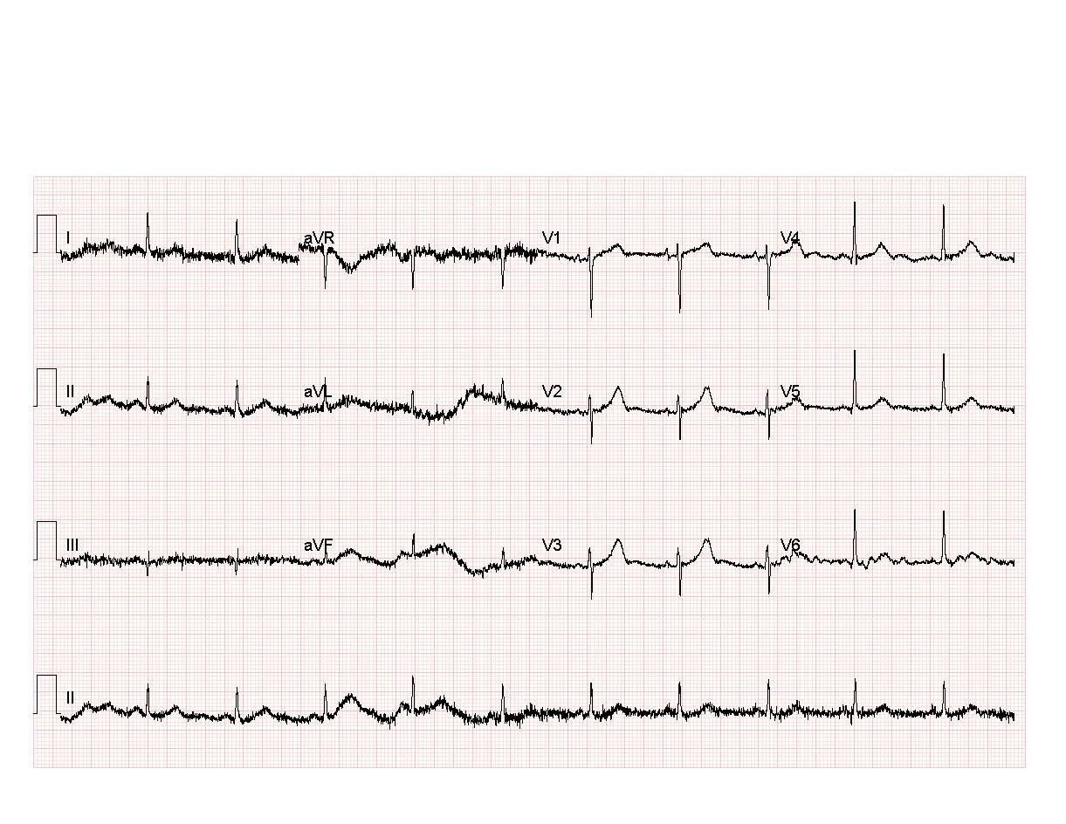
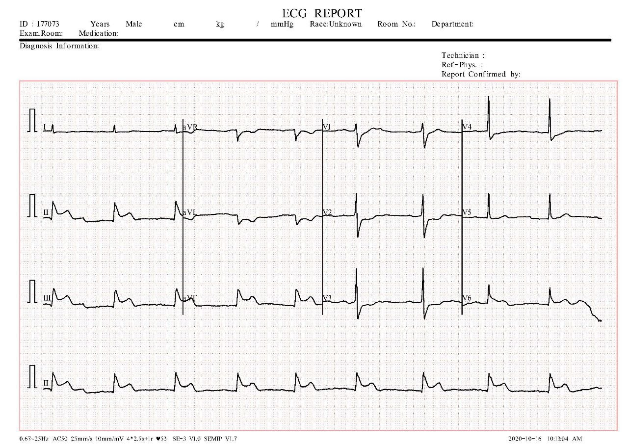
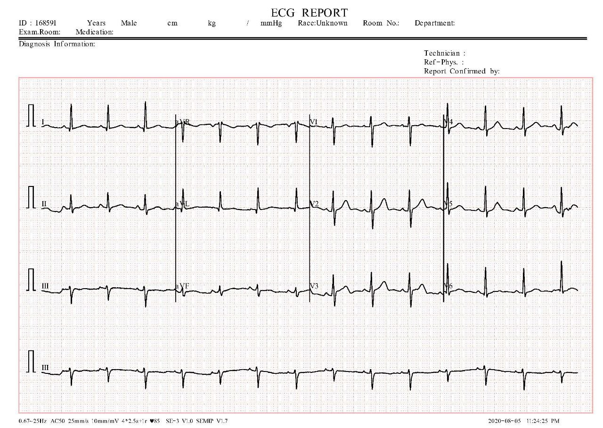
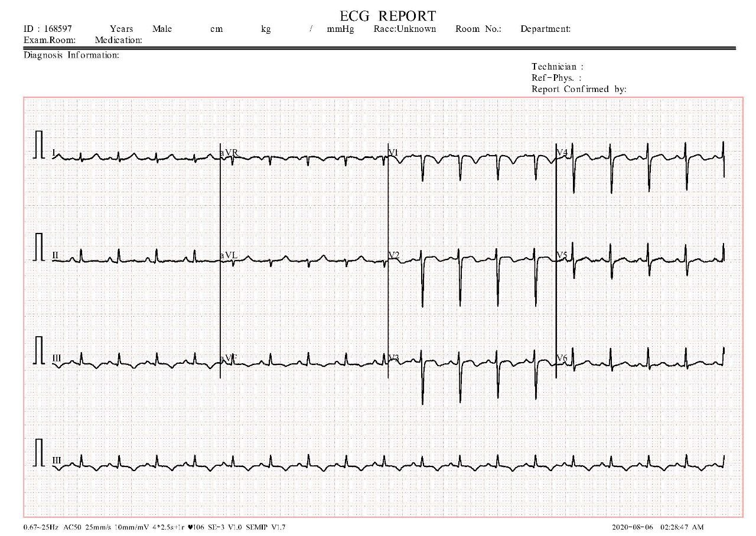
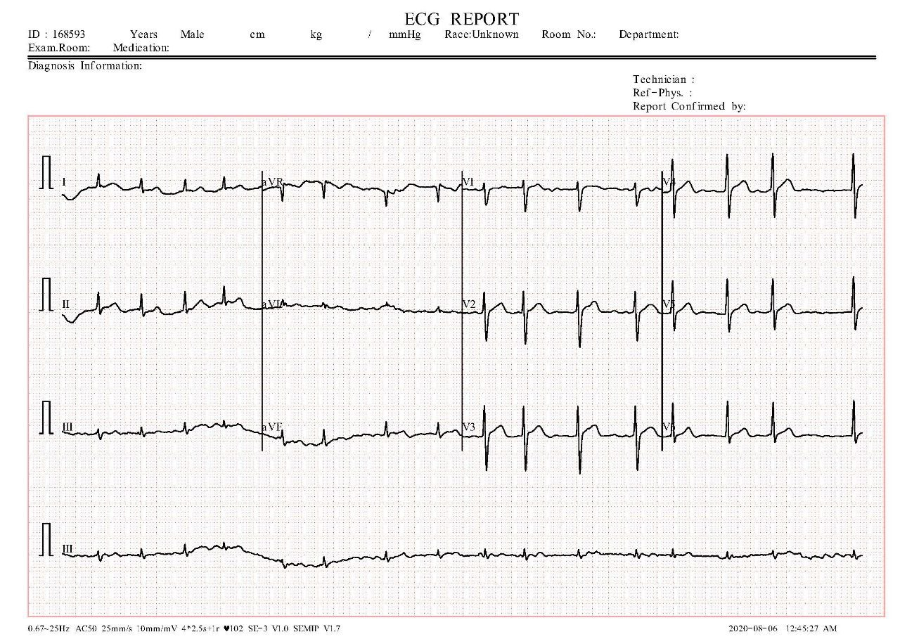
Sample of the dataset
Covid-19
Myocardial Infarction
Normal
History of MI
Abnormal heart beats

Slide 13
Dataset Challenges
Some images have unnecessary information that makes the model biased.
The resolution of images need to be preprocessed as it’s bad.
Dataset number is low.

Slide 14
Preprocessing & Models

Slide 15
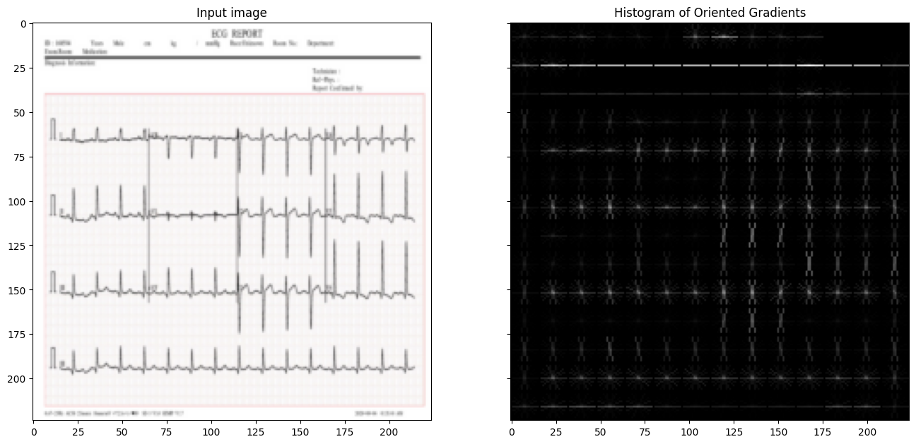
Histogram of Oriented Gradients (HOG)
Sample for using HOG of Patient that have abnormal heart beats.

Slide 16
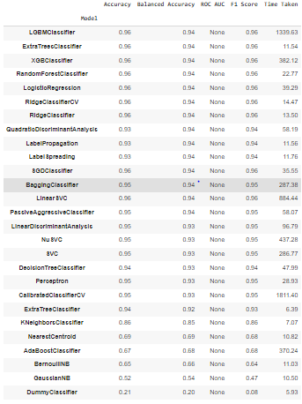
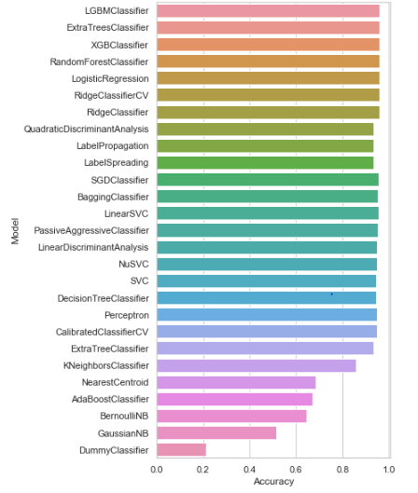
lazy classifier

Slide 17
Unnecessary info-> Rectangle Detection
Before
After

Slide 18

Bad resolution-> Gamma correction
The main advantage of using gamma correction with ECG images is that it can improve the accuracy of feature extraction algorithms by enhancing the visibility of the signal.
Gamma factor = 1.3.
Transforming images from BGR to Gray-scale
Notes:
ADD gamma equations

Slide 19
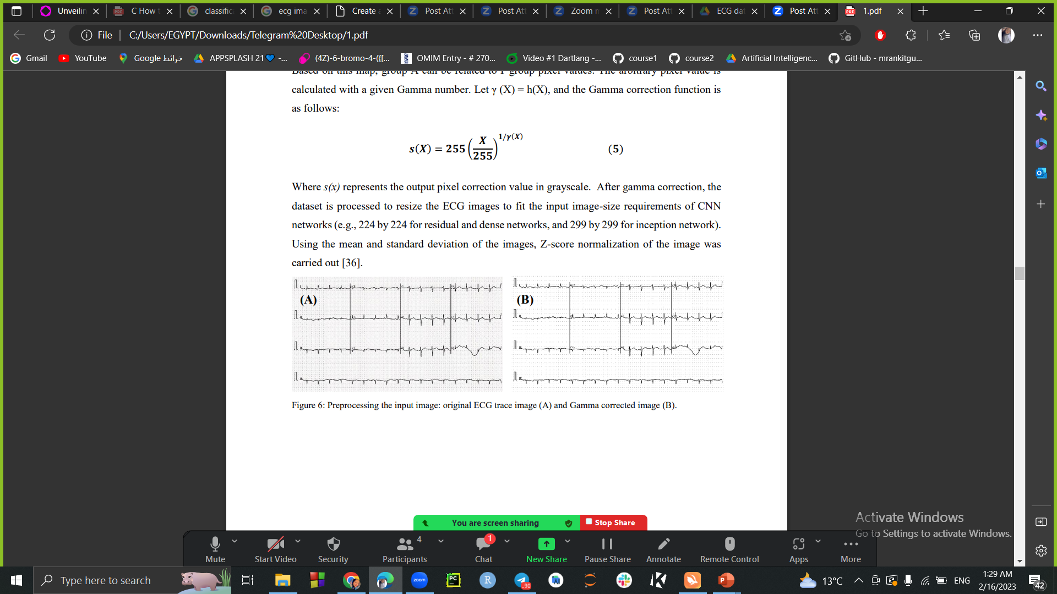
Bad resolution -> Gamma correction
Before
After
Notes:
ADD gamma equations

Slide 20
Average Accuracy
80% of data were used for training and 20% for testing. Out of the training dataset subset 10% were utilized for validation to avoid overfitting issues. Finally, the results were:
Model | Average accuracy
EfficientNetB0 | 98.062%
EfficientNetB3 | 98.065%
DenseNet201 | 97.793%
InciptionNetV3 | 97.922%
ResNet50 | 95.569%
VGG19 | 96.665%
MobileNetV2 | 10.2%

Slide 21
Final
After applying Five-fold cross validation and split the data into train, test, validation the accuracy is :
Model | Average accuracy
EfficientNetB0 | 99.000%
EfficientNetB3 | 99.085%
DenseNet201 | 98.3%
InciptionNetV3 | 98.05%
ResNet50 | 98.07%
VGG19 | 99.05%
Notes:
Limitation of VGG19 was that the storage of the model was 1.5G

Slide 22

Project specification

Slide 23
System Requirements
Functional Requirements:
Registration.
Login.
Upload image to model.
Make prediction.
Non-Functional Requirements:
Performance.
Availability.
Usability.
Security.
Reliability.

Slide 24
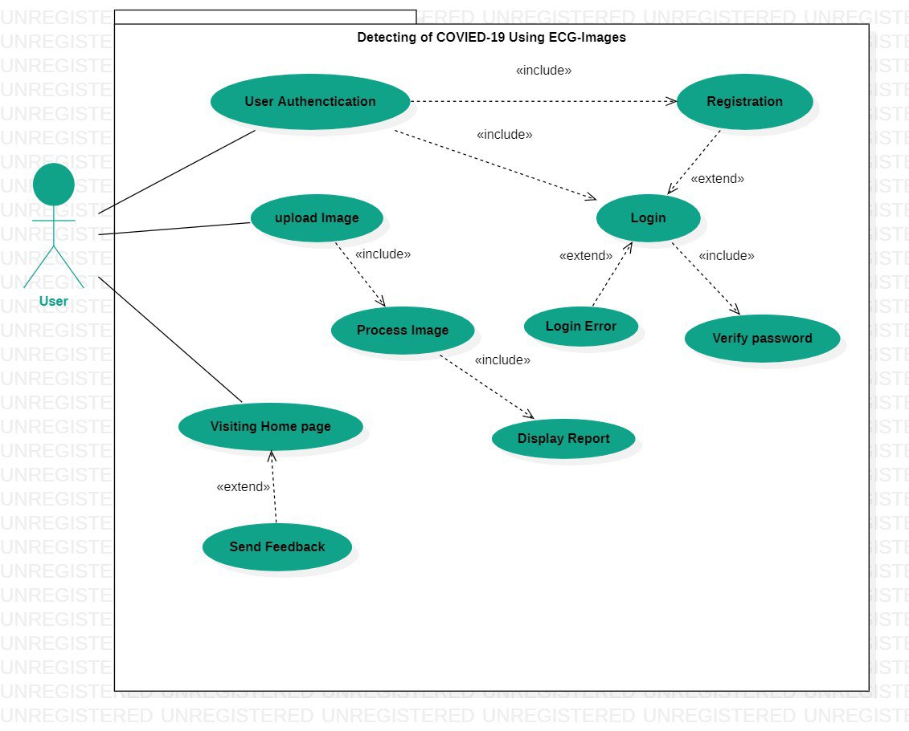
Use case diagram

Slide 25
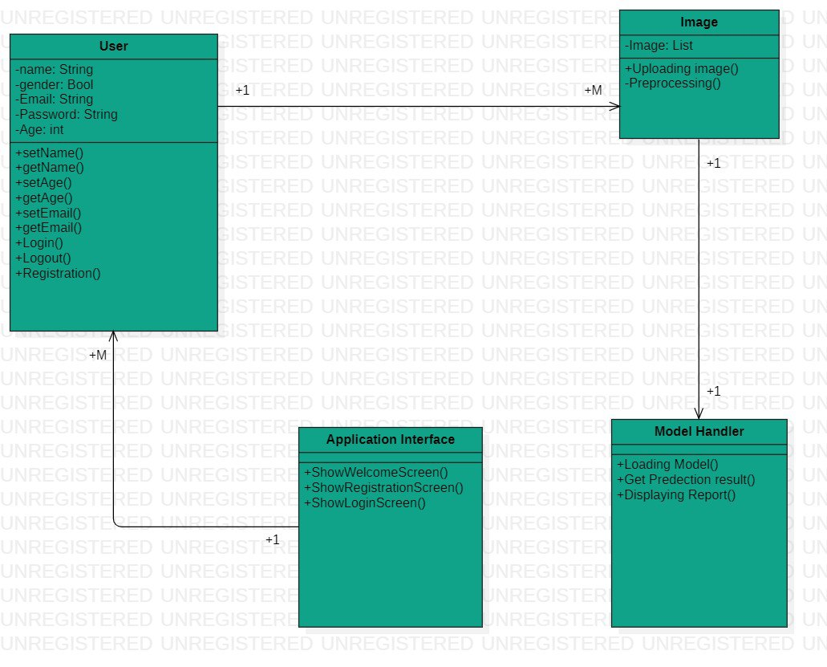
Class Diagram

Slide 26
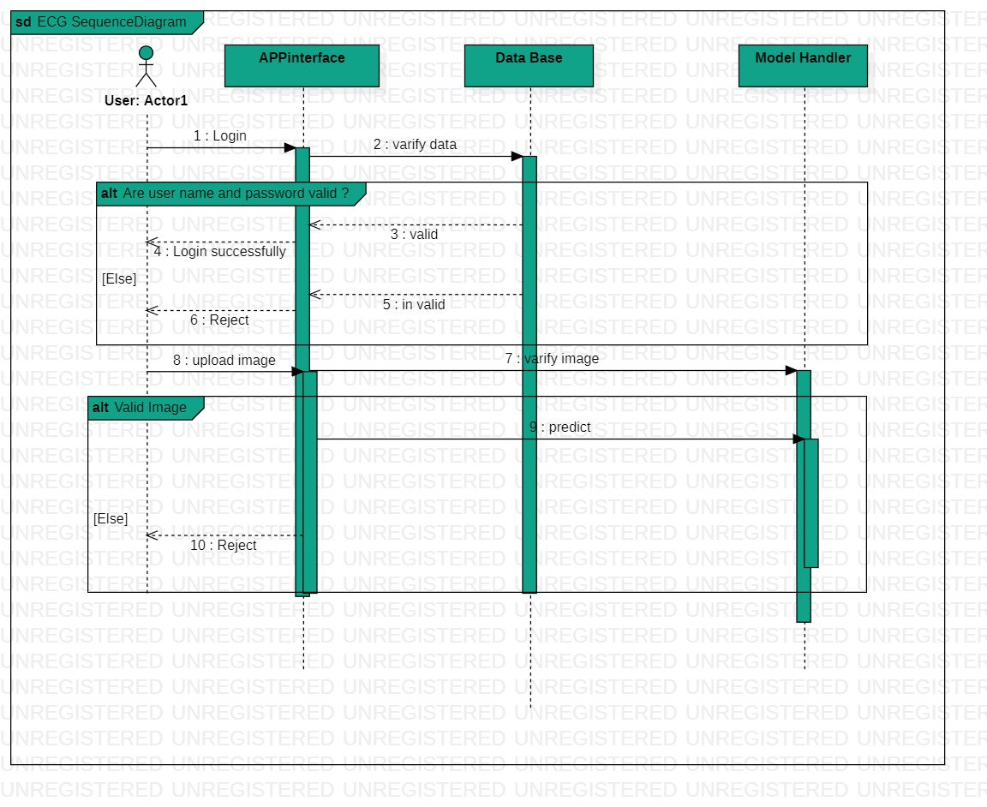
Sequence Diagram

Slide 27
Used Techniques:
To implement website | To implement mobile application
HTML, CSS, JavaScript. Laravel. | Dart. Flutter.
Flask used in implementation of API (middle where) which is connected to both.
Features of both APP and website:
Signup.
Login.
Data validation.
Caching.
Authentication.

Slide 28
Challenges of project
Data problems and Choosing preprocessing techniques.
Deployment on server.
Learning flask
Future Work
Deployment on a server.
Save the result of users.
Save the images that uploaded to the model.
Make an analysis of users' information and display it as statistics.

Slide 29
Conclusion
Using ECG data for Covid-19 detection not only heart diseases detection.
Using machine/deep learning techniques (Lazy classifier, CNN pre-trained models for doing this.
Making the use of the project easy by made website and mobile application.

Slide 30

Demo Time

Slide 31


Any Question?

Slide 32

Thank You

